Slide 1
AET Use Info www.theaet.com
Contact Jennifer Morris if you have questions about information in this packet.
jmorris@ccity.esc14.net
325-242-3907
Some of you veteran teachers may know most of what is here and will want to flip to the calendar section if you don’t already use it for your chapter. I tried to include extra for new teachers.
This power point can also be found on the Area 2 website on the VATAT tab.

Slide 2
Basic AET Info

Slide 3
AET Login Page – www.theaet.com
Make sure you log in under the correct place. Student if you kids are logging in or Chapter/Advisor if you are logging in to do work for you chapter.

Slide 4
Teacher Dashboard
When you log in as a teacher, this is the first screen you see. It is your teacher dashboard and has both color buttons that you see to the right and tabs across the top. The tabs can be accessed from the top even after you go to one of the other pages.

Slide 5
Profile Tab
You can also set up your classes in #5 so your kids will be able to add them to their applications and resumes.
This is what you see when you click on the Profile tab.
Click on #1 and #2 to update your chapter and advisor information.
#8 is where you renew, print invoice, and pay for your AET record book subscription.

Slide 6
Profile #1 - Updating AET Chapter Profile
Good to update your chapter profile as parts of it are transferred to applications.

Slide 7
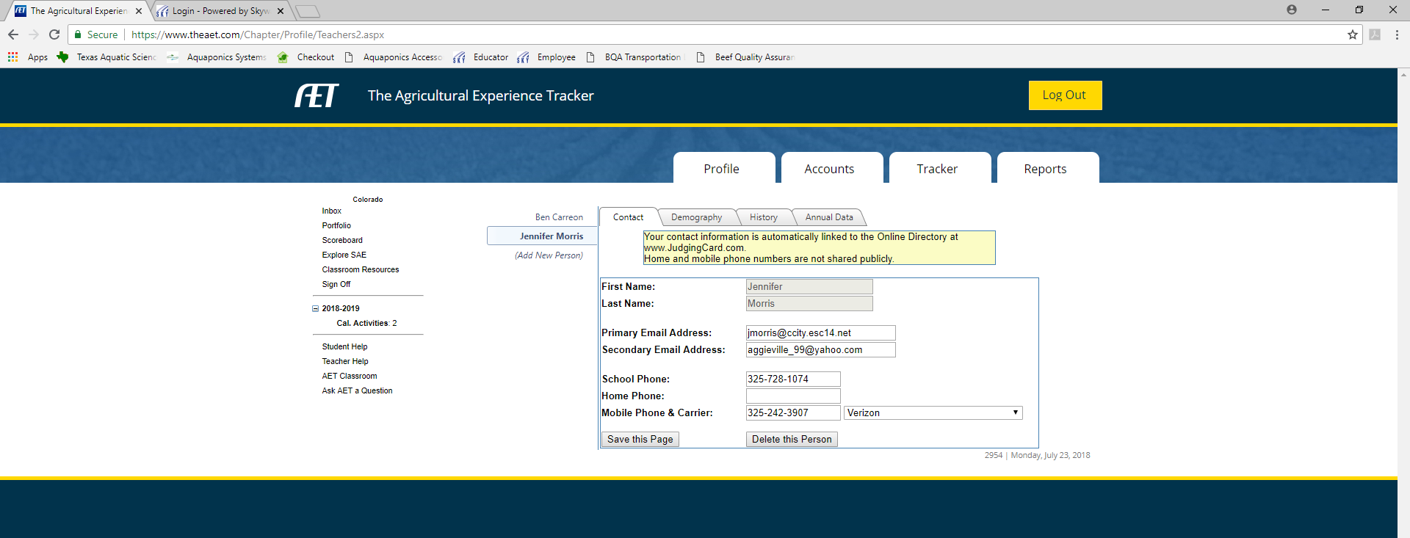
Profile #2 – Updating AET Teacher Profile - ASAP
When you update your teacher information, it updates reports, the Area Calendar, and Teacher database.
UPDATE ASAP!

Slide 8
Profile #5 - Updating & Adding Your AgSc Courses to AET
This is where you add your schools Agriculture Science classes that students will add to their resumes and books.

Slide 9
AET Student Profiles and Roster Submission
Note:
Teachers need to have all students set up a profile in AET so they may simply select the students to submit and their data is ready for submission for the Roster. Hopefully it will make your submission process much easier.
If you will add your students to AET and have them complete their profiles within the first month of school and submit your roster via AET, you will save time and your data in both the Roster and AET will match up.
Some people have been doing the roster first and have had some problems with FFA ID numbers on student record books.

Slide 10
Accounts Tab
You add student accounts here.
You can also access your students record books here with out their login.

Slide 11
Accounts #1 - Manage Student Accounts
You can add 1 student account or several student accounts here all at once.
Cane, Candy
CCane
Joy, Almond
AJoy

Slide 12
Accounts #1 - Manage Student Accounts
This is the information you will need if you enter them one at a time and he screen you enter them on.

Slide 13
Accounts #1 – Manage Student Accounts
This is the screen where you can enter multiple students at one time.

Slide 14
Teacher-side Calendar Info

Slide 15
Tracker Tab
Calendar found here at C1.
You can also set student calendar access here at C2.

Slide 16
Tracker #C1 - Updating Your Local AET Calendar
You do have the option to delete items that are not applicable to your chapter if you choose when they are entered at a level above your chapter.
The items shown on this calendar were entered by the Area.

Slide 17
Tracker #C1 - Updating Your Local AET Calendar
Teacher view of the AET calendar. Notice the items put in by the Area (VATAT Conf) show up as well as the items entered by the chapter teacher. You have the choice to color code your events when you input information.
To input: click on date and add event information.
The item highlighted in blue was entered at the chapter level by the advisor.

Slide 18
Tracker C1 – Adding activity to calendar
Screen that comes up when you click on date on calendar to input activity information.

Slide 19
Tracker #C2 - Student AET Chapter Calendar Editors/Updaters
You can set some of your students up to help you manage (add, edit) your chapter calendar activities.
Duty, Jury
Candy
Cane
Almond
Joy
Milky
Way

Slide 20
Applications

Slide 21
Reports Tab
F1 under FFA Reports & Submissions is the FFA Awards Degree/Application Manager. You can find your student and/or chapter applications listed here. You can also edit & generate printed applications here.

Slide 22
Reports #F1 – FFA Awards/Degree Application Manager
Choose Application in blue by the students name that you want to check/edit. You can also Add Application from this screen.

Slide 23
Student Login

Slide 24
AET Login Page – www.theaet.com
Make sure you log in under the correct place. Student if you kids are logging in or Chapter/Advisor if you are logging in to do work for you chapter.

Slide 25
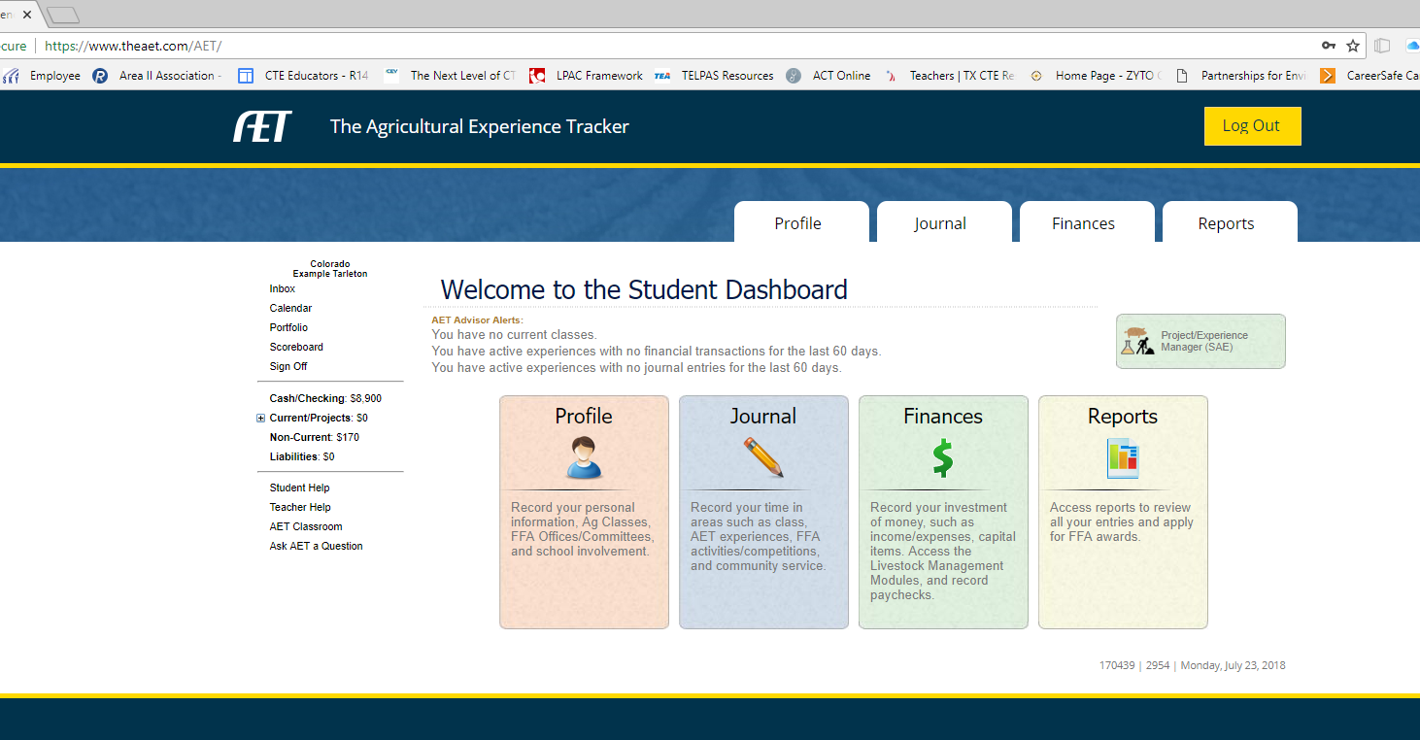
AET Student Profile Setup (must login as a student once you set students up)
Once student logs in, they will need to complete as much information as they have for the Profile Tab: About You, Your Activities, and Career Connector.
The Profile tab takes you here. Circled items in the About You column should be completed prior to Roster Submission.

Slide 26
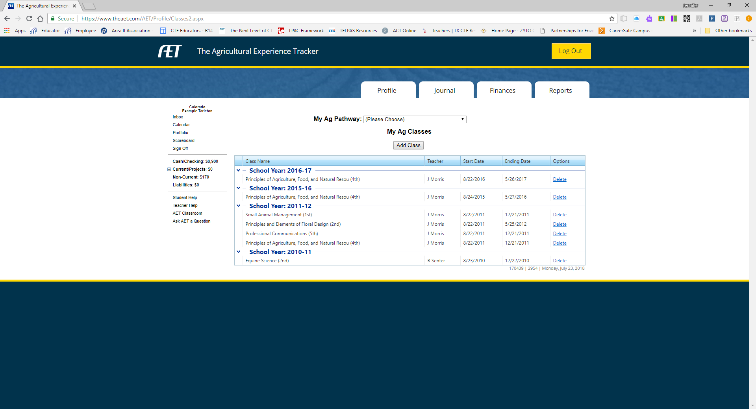
AET Student Profile Setup Manage/Edit Profile and Ag Class Schedule
This is what your kids will see when they update their profile (pictured to the left) and their Ag classes (pictured below). If you have not enter classes your chapter provides then nothing will show for them. Make sure you get them added.

Slide 27
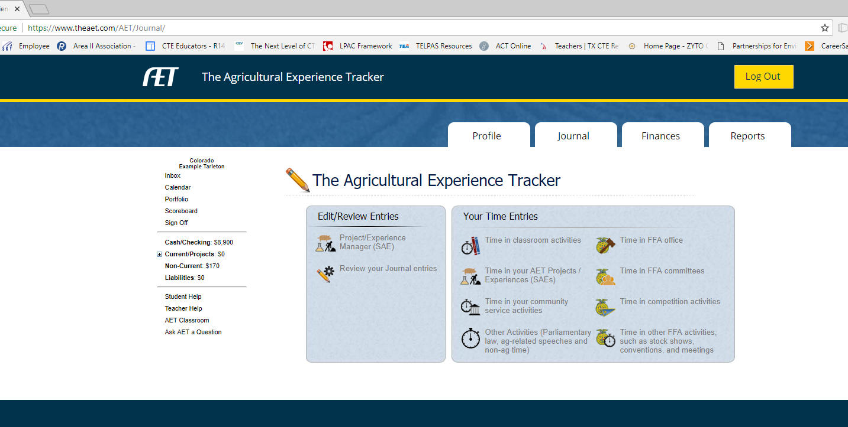
AET Student SAE Project Experience Manager
AET Student Profile & Journal tabs both include the SAE Project Experience Manager as well as its own button on the dashboard. This is how your kids will set up their projects in their online record books.
Students will also enter their time in activities on the Journal tab.

Slide 28
Student Access to Calendar
Students can find the calendar here.
Student view of the AET calendar.
Student activity view with no editing access.

